Slide 1
Advanced Training Strategies: Pyramid Search
Genetic Programming
By Thanushan Pirapakaran, Adrian Binu, Brett Terpstra

Slide 2
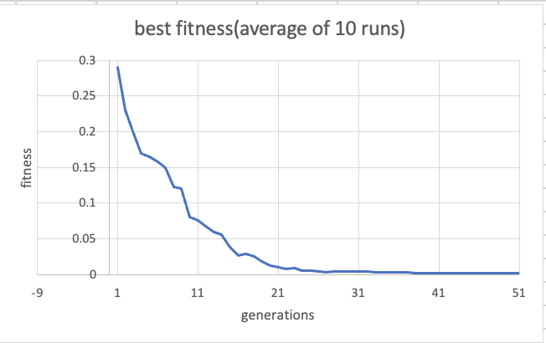
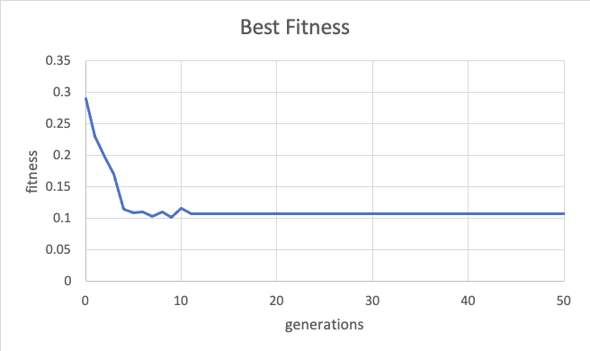
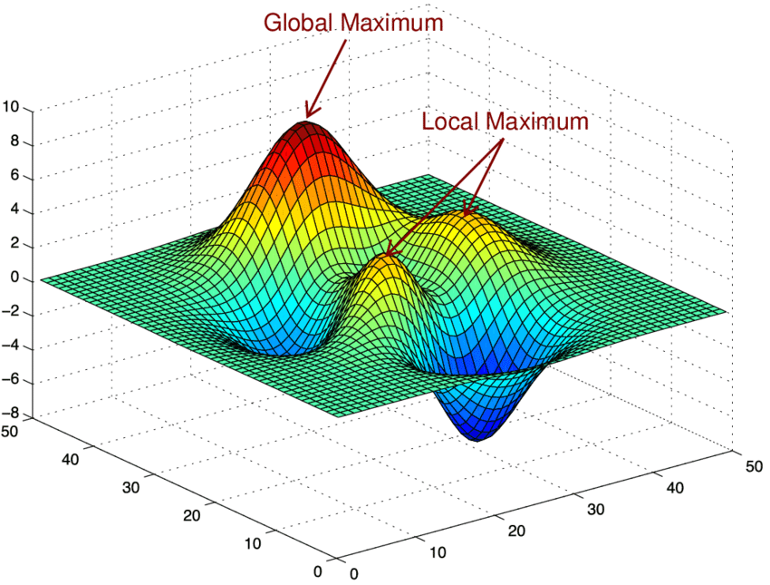
Normal Graph
Premature convergence

Slide 3
Idea:
Run many independent GP runs at the same time (in Parallel)
Compare fittest individuals between the program's populations
Prunes least fit populations
No sharing of individuals between populations

Slide 4
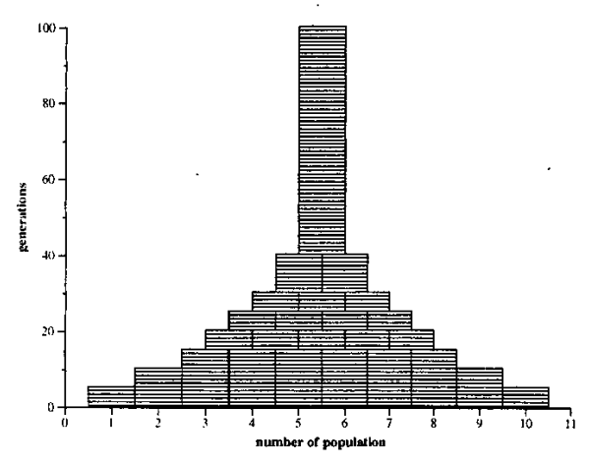
Pseudo Code

Slide 5
num_pop = 5
pop_size = 50
prune_ratio = 0.2
num_gen = 10
max_generations: 50
Number of populations to prune
= roundUp(pr*np) = 1
Our best fit population
50th gen
NOTE: For this example, bigger fitness values is better
Pop. 4
Fittest: 20
40th gen
Pop. 2
Fittest: 15
Pop. 4
Fittest: 16
30th gen
Pop. 2
Fittest: 15
Pop. 3
Fittest: 11
Pop. 4
Fittest: 12
20th gen
Pop. 2
Fittest: 5
Pop. 3
Fittest: 11
Pop. 4
Fittest: 9
Pop. 5
Fittest: 4
10th gen
Pop. 1
Fitness: 2
Pop. 2
Fittest: 5
Pop. 3
Fittest: 10
Pop. 4
Fittest: 9
Pop. 5
Fittest: 3

Slide 6
Pros of Pyramid Search
Great for large scale problems or if the problems have a complex fitness landscapes with multiple local optima
It is faster than running multiple vanilla GP runs because it prunes out worst fit runs
It has a higher probability of success with fewer evaluations

Slide 7
Cons of Pyramid Search
There are now more parameters to consider and to optimize
Pyramid Search has to maintain multiple runs so it increases the memory demand
Depends on setup and intention, running the same number of subpopulations, pyramid search uses less memory vs running all to completion
Pyramid search's increased memory requirements comes from having to run many subpopulations at the same time.

Slide 8
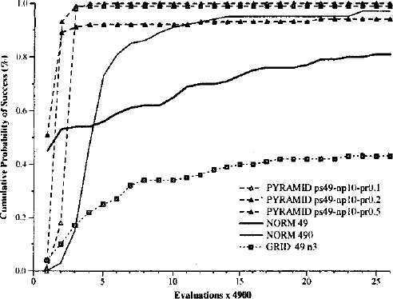
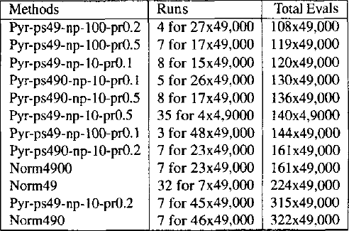
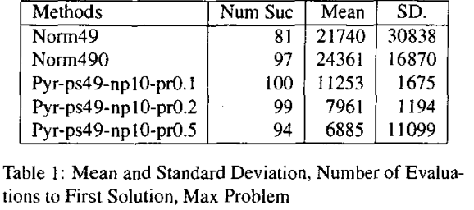
Pyramid Search vs normal paper comparison
Pyramid search has high probability
of success with fewer evaluations
"total evaluations" typically refers to the total number of fitness evaluations performed during the execution of the algorithm.

Slide 9
WE IMPLEMENTED IT!!!!
The parameters the paper used
Variables
num_pop = 10
pop_size = 50
prune_ratio = 0.2
num_gen = 10
max_generations: 100
Before we implemented it we were looking for a speedup, an improvement in premature convergence, overall fitness results and memory consumption

Slide 10
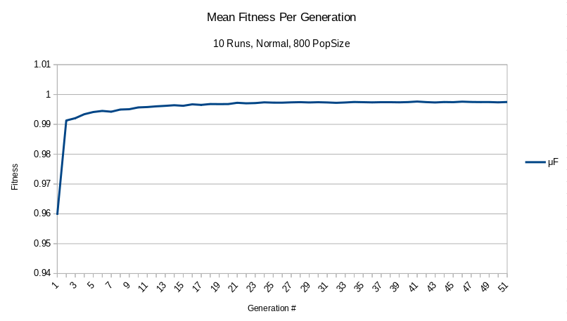
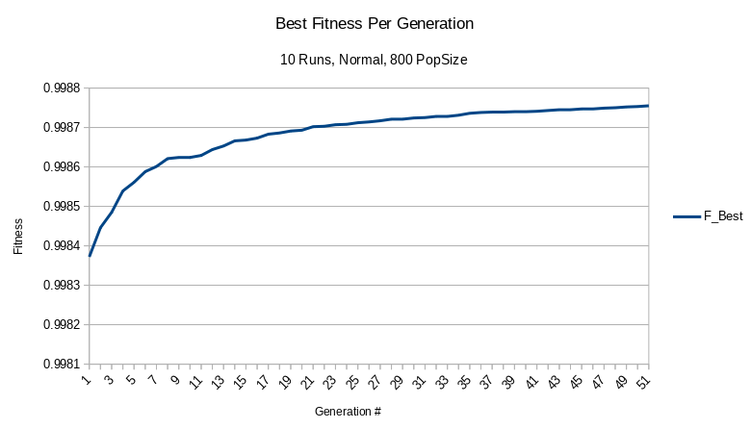
Assignment 1 Part B
Assignment 1 part B also suffered from premature convergence

Slide 11
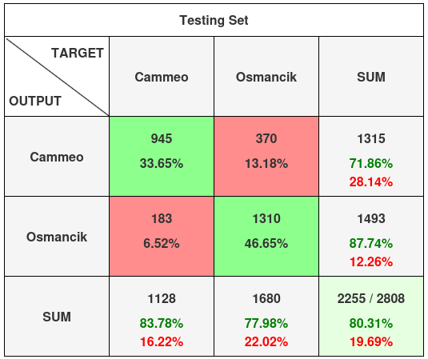
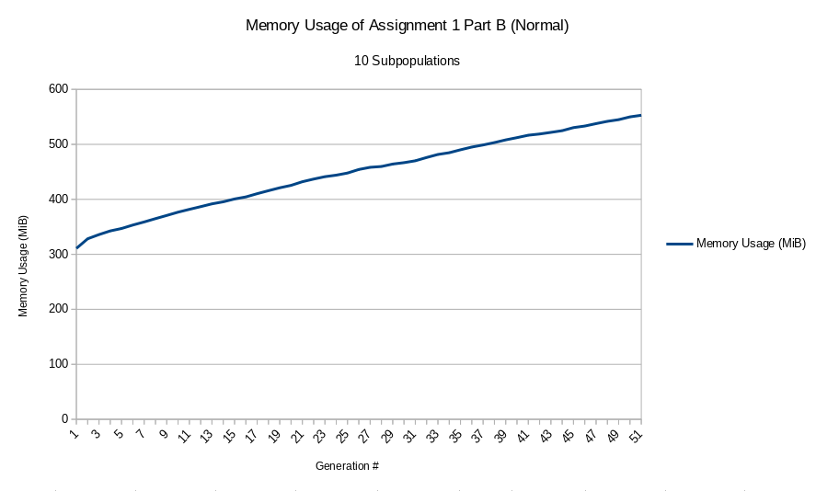
Assignment 1 Part B Cont.
Average Execution Time 6.786 Seconds

Slide 12
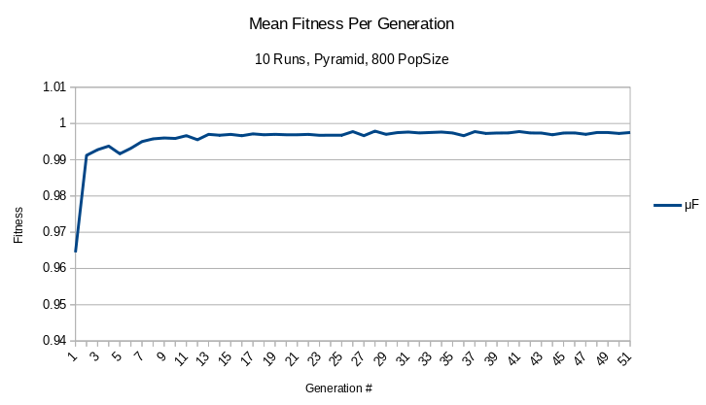
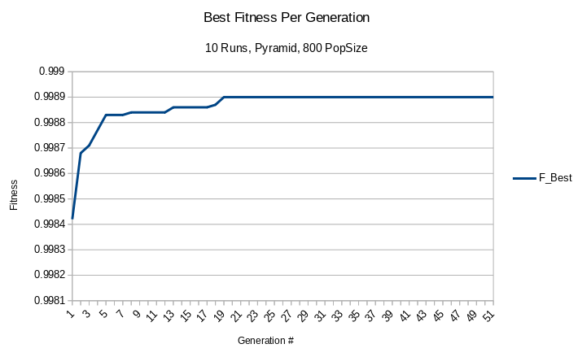
Applying Pyramid Search To Assignment 1
Using 10 sub-populations, a prune ratio of 0.2 and 10 generations between pruning

Slide 13
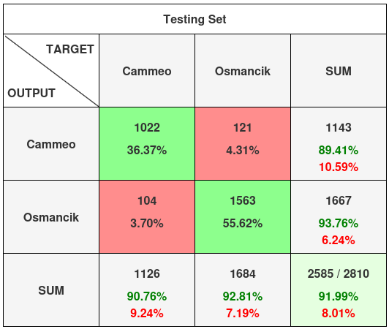
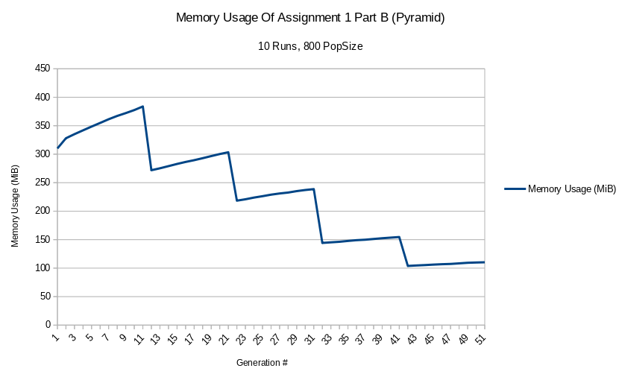
Applying Pyramid Search To Assignment 1 Cont.
Average Execution Time 4.6055 Seconds
Before it was 80.31%

Slide 14
Conclusions
Running pyramid search gave better results on average in less time
According to our tests we did not reduce premature convergence or increase genetic diversity of our populations
Peak memory usage was less than running 10 subpopulations without with pyramid search

Slide 15
References
[1] Ciesielski, V., & Li, X. (2003). Pyramid search: finding solutions for deceptive problems quickly in genetic programming. CEC: 2003 CONGRESS ON EVOLUTIONARY COMPUTATION, VOLS 1-4, PROCEEDINGS, 2, 936-943 Vol.2. https://doi.org/10.1109/CEC.2003.1299767
[2] Rice (Cammeo and Osmancik). (2019). UCI Machine Learning Repository. https://doi.org/10.24432/C5MW4Z.
[3] Poli, Riccardo, et al. A Field Guide to Genetic Programming. Lulu Press, 2008.

Slide 16
The MAX Problem from the Paper
Goal is to find maximum value for a given depth using a GP with a function set of {x, +} and terminals of {0.5}
Desired solution is a full tree with 0.5 on all terminals
This problem which was presented in the paper is known as a "deceptive problem" that "displays obvious premature convergence behaviour"

